Slide 1
iOS Automation

Slide 2
Agenda
Locators in iOS
PickerWheel Automation
Multi region & Language Testing

Slide 3
Locators & IOS

Slide 4
XPath & iOS
XPath queries are no longer recommended for iOS Devices
Apple has released a new test automation infrastructure – XCUITest
XPath queries on ioS 11+ will be slow & cause performance issues
Creating custom locators for iOS with the correct strategies is fast & reliable.
Notes:
Apple has introduced a new standard for working with iOS devices. While XPath still works, it is slower and not guaranteed to work in future iOS versions.
The new methods for identifying objects are faster and aligned to Apple’s best practices.
There are several options, which we will walk through.

Slide 5
The Alternative is ….
There are several alternatives to XPath
All are similar and contain the same basic principle – identifying an element in a short readable way.
The various options are dependent on the application being tested.
For ID’s to be identified they must exist in the code
We will look at the options in order of performance.
Remember … study your application before deciding on the method.
You can choose more than one!

Slide 6
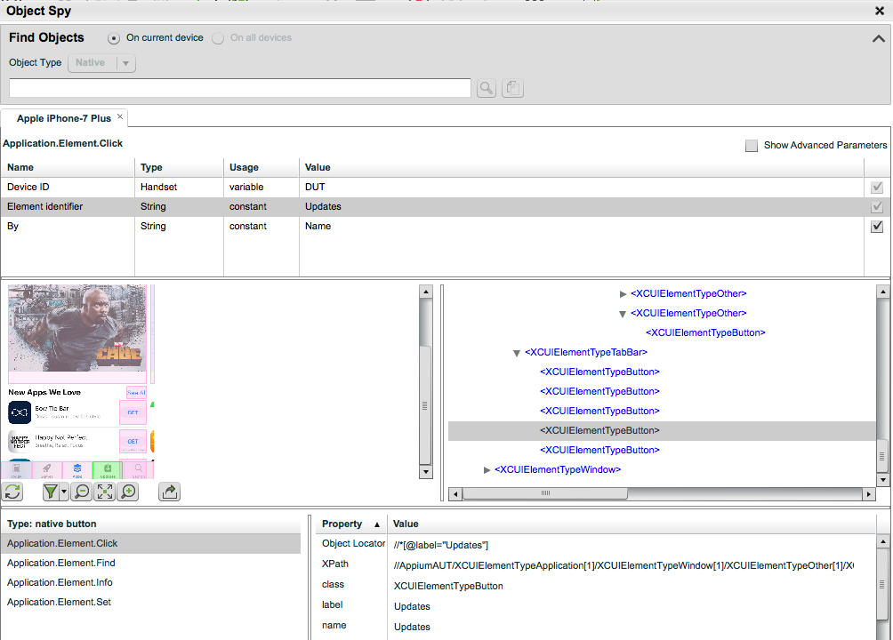
Using the Object Spy
The Spy contains the info we need
We need to use it in a new way.
Notes:
Open the object Spy & demonstrate on it.
Show that the information – className, name, accessibilityID are visible in the Object spy.

Slide 7
Why are there different methods?
We will look at several strategies for identifying objects
There are multiple options because iOS allows it & the best fit depends on how the application is written.
The strategies are presented in order of performance
Any one you select will be fine and superior to XPath
Learn your app before you start
Remember that you can use multiple strategies!

Slide 8
className
The className identifies the object according to the class
The class is frequently NOT Unique e.g. XCUIElementTypeButton
The identification is therefore per page e.g.
If you are looking for the 2nd button on the page you can get the list of elements with that class with the findeElements method and then select the required object.
The main disadvantage is dependency of the object to the relationship to other objects in the page.

Slide 9
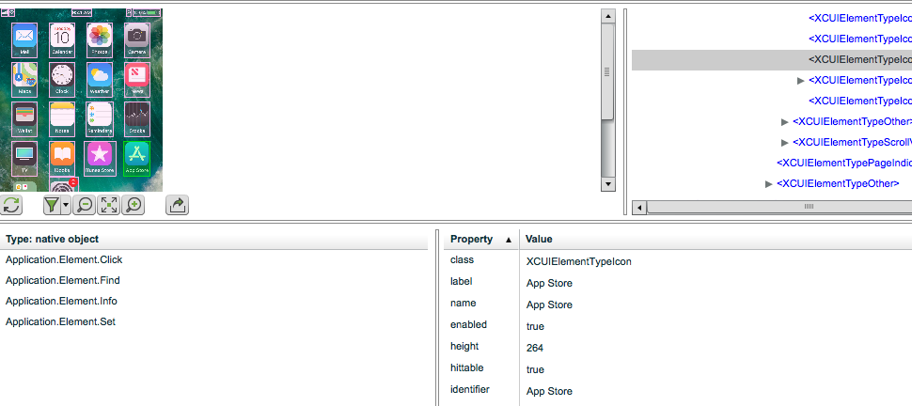
Identifier
The Identifier is a unique identity to the object.
It is the easy to find in the Spy & simple to define
Usage requires the developer to define an identifier per object.

Slide 10
Name
The Name property is equal to the identifier and can also be used

Slide 11
linkText
Captures the name attribute value automatically
Like identifier & name – easy to recognize & define
This method also makes sense in terms of user experience i.e you define the link the user will click on.
driver.findElementByLinkText('My Link');

Slide 12
Advanced Methods
Predicate Queries allow constructing a query similar to XPath
They are a logical statement that describe the object Type == 'XCUIElementTypeButton' AND value BEGINSWITH[c] 'bla' AND visible == 1
classChain is similar, with a different syntax and allows building a complete hierarchical statement.
We will not delve into these 2 options as the simpler methods shown before are adequate for the need. Users who are already familiar with them are free to use.

Slide 13
Are you confused?
It is simpler than it looks. Follow these instructions:
Check your application. What does it provide?
Try to use identifier, name & linkText
Use the className if needed
The Predicate & className are for advanced users only.

Slide 14
Picker Wheel Automation

Slide 15
Selecting Values in Picker wheel
The Picker Wheel is commonly used in iOS for selecting dates and other data inputs.
There are 2 methods for interacting with the wheel, depending on how the element was developed:
Title For Row - The Picker Wheel values are defined as a String In this case a simple sendKeys method is sufficient element.sendKeys("title");
View for Row - The Picker Wheel Values are defined as a view This requires scrolling to the required value See - https://developers.perfectomobile.com/display/TT/PickerWheel+Automation
Notes:
The Picker Wheel is a common hurdle in many applications.
We’ll look at 2 samples here – one when the wheel is defined as a String and one when it is a value.
Unfortunately there is no way to know from the application what type of wheel it is as this is a backend property. Therefore it is best to try the title option first.
Since Title rows are much easier to automate, you should inform your Dev team of this for them to take this into account.

Slide 16
Picker wheel Samples - & Hands on
Run the samples for title & view
Hands on: Implement the picker wheel for XXX

Slide 17
Multi Language & Region

Slide 18
Multi Region & Language Testing
Applications that have a global customer base are available in many languages.
Setting the language & region is easily done through the capabilities & provides the ability to run tests for the entire install base.
This is an iOS only feature
capabilities.setCapability("language", "es"); // language is Spanishcapabilities.setCapability("locale", "es_UY"); // region is Spanish (Uruguay)

Slide 19
Robust iOS Executions

Slide 20
Robust iOS Tests – Execution Time
The iOS driver develops memory issues on the device during long executions. To avoid this problem Perfecto recommends:
Split test executions into shorter driver sessions.
For customers using only iPad Pro or iPhone 7 or newer devices driver sessions should not exceed 2 hours
For customers running tests also on older devices, driver sessions should not exceed 1 hour.
The term driver session refers to the time period from the point of IosDriver creation until the point in which driver is closed.

Slide 21
Resources
​Finding elements - https://developers.perfectomobile.com/display/TT/Finding+Elements+on+XCUITest+devices
XCUUTest Automation - https://developers.perfectomobile.com/display/TT/XCUITest+Automation
Predicate Queries - https://github.com/facebook/WebDriverAgent/wiki/Predicate-Queries-Construction-Rules
Picker Wheel - https://developers.perfectomobile.com/display/TT/PickerWheel+Automation

Slide 22
Assignment
Write a test on iOS that creates a calendar event with the following properties:
Title
Location of your office address
Time zone of your office address.
Monthly Event for 6 months
Event starts at 09:30 and lasts 45 minutes
An alert for the event
Travel time of 30 minutes to the event.

Slide 23
Thank You

